Slide 1
Functions

Slide 2
What are functions?
• Block of code that can be executed independently and repeatedly
• Less duplication, more reusability
• Arguments for variability
• Return for output and early exit

Slide 3
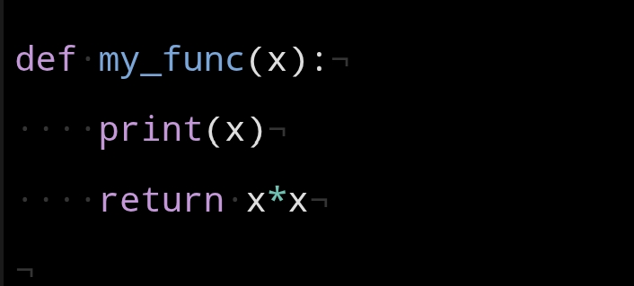
Syntax

Slide 4
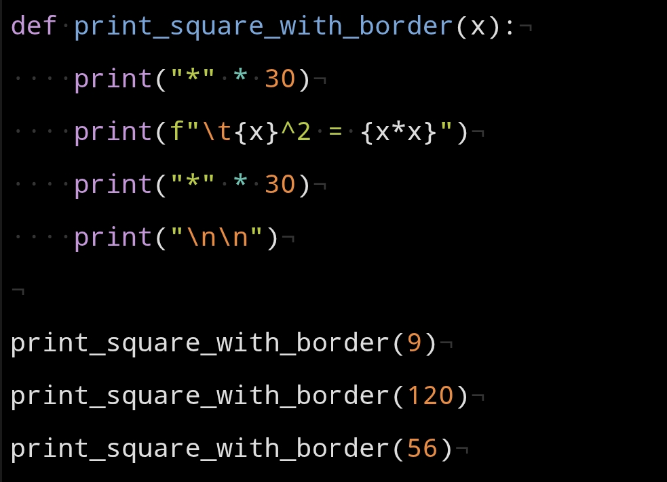
Example

Slide 5
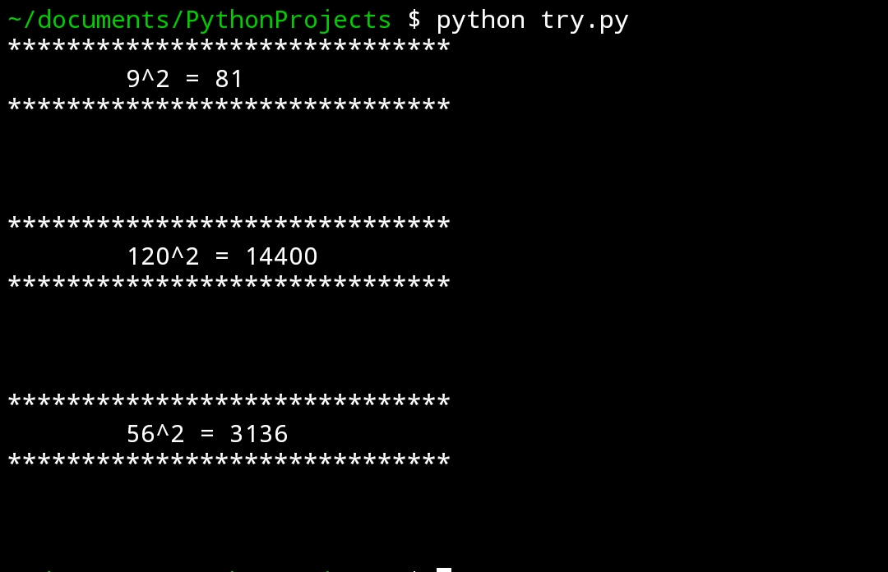
Output

Slide 6
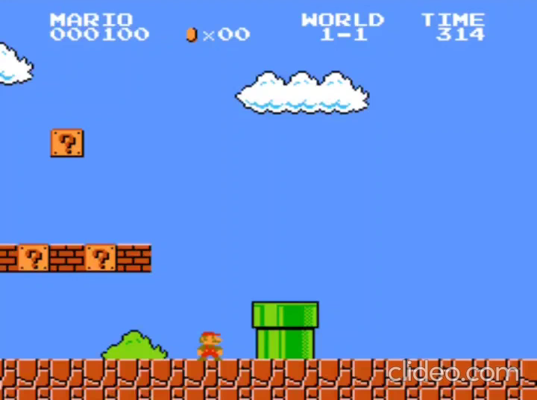
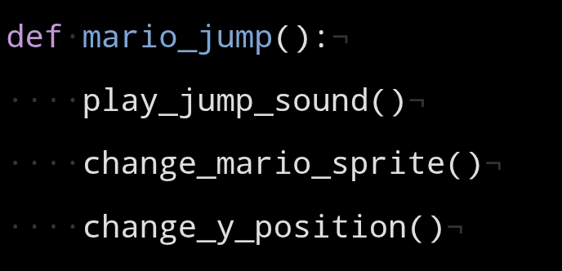
Functions in action

Slide 7
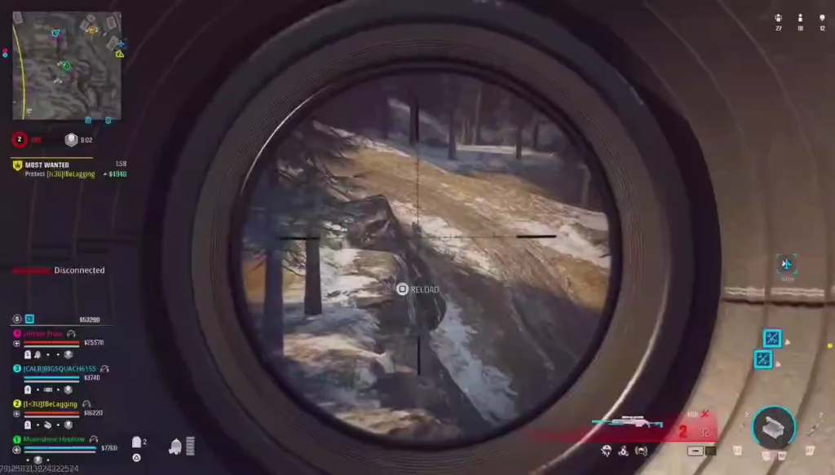
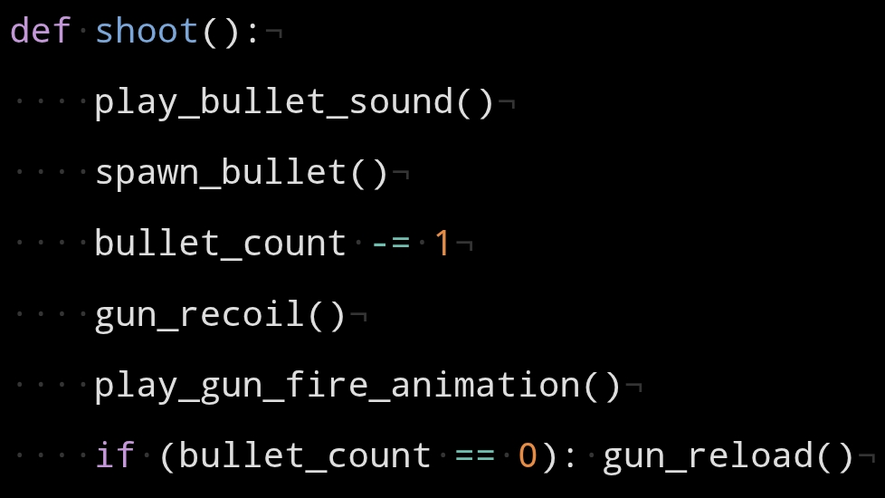
Shooting in Games
Divide tasks into smaller bits!

Slide 8
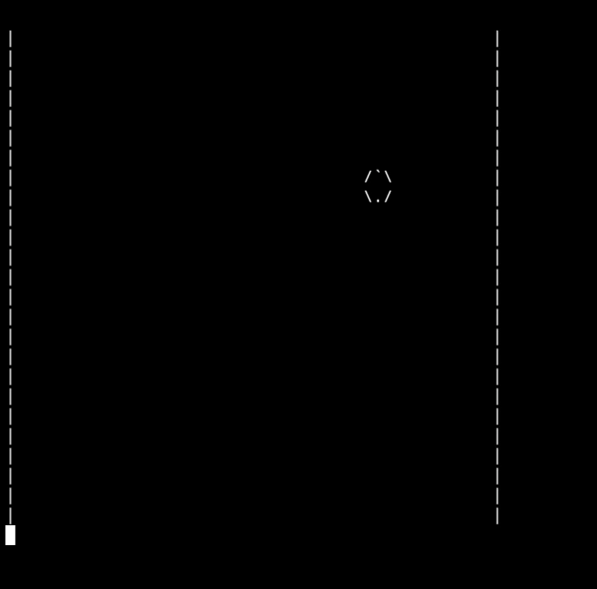
Bouncing ball with functions
Repetitive Parts:
• Ball Drawing
• Moving the ball

Slide 9
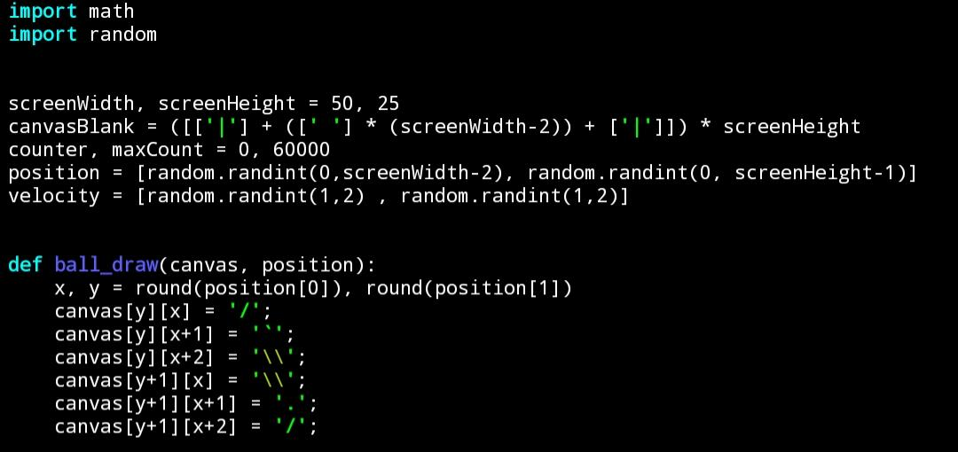
Code

Slide 10
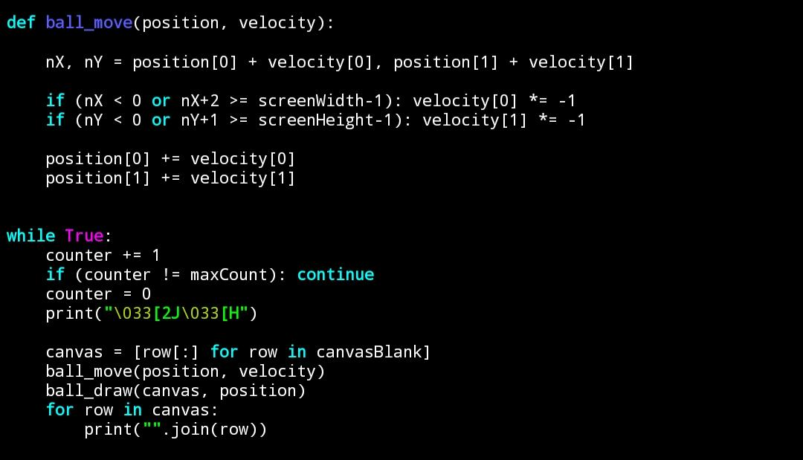
Contd..

Slide 11
Thank You

